Slide 1
Student Loan Balance & Repayment Trends in the FRBNY Consumer Credit Panel
PRELIMINARY, PLEASE ASK US BEFORE CITING
Donghoon Lee and Meta Brown
June 6th 2012
The views expressed are those of the authors and do not necessarily represent the views of the Federal Reserve Bank of New York or of the Federal Reserve System

Slide 2
Student Loan Balance & Repayment Data
As far as we can tell, sources are limited.
Department of Education
Sallie Mae, private lenders
Mark Kantrowitz/finaid.org
2003 Transunion data from Board
Aggregates in the G.19
SCF
Our data: the FRBNY Consumer Credit Panel (CCP)
Panel of loans, individual- and household-level, based on individual credit reports from Equifax.
Quarterly reports on HH credit conditions, blogs, internal & external publications
Source: FRBNY CCP/Equifax

Slide 3
Representative Panel and Household Matching
CCP/Equifax Sample Design
Unique sample design generating a longitudinal quarterly panel of individuals and households from 1999-2012.
Universe: entire US Population with credit files (240 million individuals per quarter, aged 18 and older.)
Sample selection: representative 5% using last 4 digits of SSN + All household members
Household matching: based on home address
Representative sample of US individuals and households (about 40 million individuals per quarter)
directly consistent with macro time-series statistics such as G19
Source: FRBNY CCP/Equifax

Slide 4
CCP/Equifax Sample Design
Details of the sample design and creating sample weights:
An Introduction to the FRBNY Consumer Credit Panel, Lee and van der Klaauw, 2010
Source: FRBNY CCP/Equifax

Slide 7
Aggregate Student Loan Trend
Aggregate student loan balance has grown dramatically over the past 13 years, more than doubling since 2005.
Aggregate student loan balance now larger than aggregate credit card balance.
While all other consumer debt categories declined from their 2008Q3 peak (some substantially), student loans have continued to grow rapidly:
All other consumer debt off 12 percent, or $1.53 trillion, since 2008Q3.
→ Aggregate student loan balance up 48 percent, or $292 billion, since 2008Q3.
Source: FRBNY CCP/Equifax

Slide 10
Student Loan Delinquency Rate
Historically, student loans and credit card debt most delinquent.
Perhaps surprising, given student loans associated with higher skilled borrowers.
but younger borrowers have substantially higher delinquency rates.
& credit card and student loan are uncollateralized debts.
While mortgage, credit card and auto delinquency have declined substantially from their 2010 peaks, student loan and HELOC delinquency remain at or near peak.
All non-SL consumer debt % of balance 90+dpd peaked at 8.7 in 2010Q1, fell to 6.8 by 2012Q1.
Student loan % of balance 90+dpd 8.7 in 2010Q1, 8.7 2012Q1.
14% of student loan borrowers have some past due balance.
Source: FRBNY CCP/Equifax

Slide 11
What is driving the growth in balance?
More students?
Higher balance per student?
Lower repayment rate among past borrowers?
Source: FRBNY CCP/Equifax

Slide 14
Who are student loan borrowers?
Source: FRBNY CCP/Equifax

Slide 15
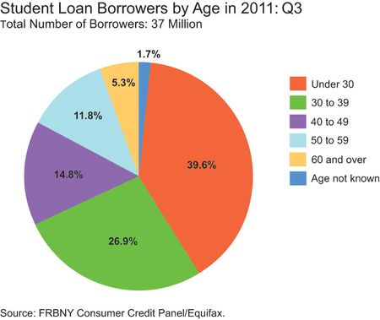

Slide 16
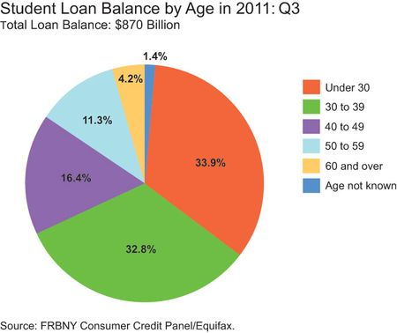

Slide 20
Who is paying down? Who is accumulating?
Source: FRBNY CCP/Equifax

Slide 26
The youngest borrowers
Source: FRBNY CCP/Equifax

Slide 29
Summary
Aggregate student loans have increased severalfold since 1999Q1
→ now the second largest consumer debt category.
While all other consumer debt categories declined in balance and became less delinquent since 2009, aggregate student loan debt has continued its long upward trend and become more delinquent.
This debt accumulation is driven by
More students,
Higher balances per student and
Slow rates of paydown among past borrowers.
Past borrowers under 50 show no evidence of paydown in the aggregate. Aged borrowers show only modest paydown. 40-49 year old borrowers have high and growing delinquency rates.
Young student borrowers are accumulating debt at unprecedented rates and have lost default recourse.
Source: FRBNY CCP/Equifax

Slide 30
Additional slides

Slide 31
The FRBNY Consumer Credit Panel
Panel of loans, individual- and household-level, based on individual credit reports from Equifax
Ability to track individual borrower over time: can link over refinances, geographic moves, consolidation; can analyze entry into home-ownership or student borrowing, can follow pay-down
Ability to link multiple loans for same person at any point in time: multiple first mortgages, additional first/second mortgages, debt substitution, delinquency profile across various loan types
Ability to link individuals in the same household: credit/loan situation of all family members – total exposure and distribution within household
Account for new entries and exits in a systematic way : Capture a balanced flow of individuals into and out of the data

Slide 32
Main Features of FRBNY CCP
Longitudinal information on all individual mortgages: first mortgages, closed-end seconds, HELOCs
Individual mortgage account variables: opening date, origination amount, current balance, credit limit, delinquency status, individual/joint account, term/monthly payment, GSE loan, narrative codes detailing credit events such as foreclosure
Consumer level information on auto loans, credit cards, student loans
Consumer-level auto loan, credit card, student loan data: Total balance and # accounts, delinquency detail, origination amount and credit limit
Public record information
Public record information on bankruptcies, collections, tax liens
Individual characteristics
Borrower characteristics: birth year, geographic location (state, zipcode, census block)

Slide 33
Student Loan information : Roll-up variables
Servicers with ZZ (miscellaneous servicers) were dropped from credit trend variables. (account level exclusion)
This includes department of education !!
Credit trend variables and CMA variables are pre-set, and all the revisions should be made through custom attributes.
Since 2Q2011, custom attributes were modified to include the omitted accounts. (2Q2011 has supplemental files to replace the original)
Prior to 2Q2011, this is achieved by loan level data (FRBNY and FRBP RADAR group) and added / updated for each quarter before and after. (currently being evaluated for data integrity.)
5% primary samples for 2011 and before, including family members since 2012.

Slide 34
Student Loan information : Loan Level
Detailed Loan level information on origination date, origination amount, balance, delinquency status, terms/payment, narrative codes (such as payment deferred, collection account, etc), past due amount, scrambled account number and servicer number.
Up to 20 accounts from the biggest balance to the smallest. Roll up variables are not restricted by this max number.
Useful for calculating originations, payment behavior, consolidations, defaults and accounting for servicer reporting practices.

Slide 35
